Slide 1
Cilia
Marissa Serhan
Kevin Johnson
Matt Monaghan
Cindy Guizar

Slide 2
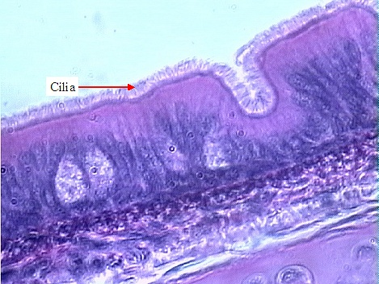
What is it?
A microscopic flexible hair-like membrane extension of the cell
It can vary in length from a 1-10 micrometers and are less than 1 micrometer wide
Cells can have millions of cilia!
Two types:
Motile
Primary (non-motile)

Slide 3
Where is Motile Cilia found?
Middle ear
Ependymal cells that line the brain vesicles
Respiratory Tract
Nose
Pharynx
Trachea
Lungs
Fallopian Tubes (AKA oviduct)

Slide 4
What does Motile Cilia do?
Bend and beat in a wave form
Can be either planar or three-dimensional
Can measure the amplitude, wavelength, and frequency
Dislodge and expel particulate matter that collects in mucus secretions
Moves the particles up toward the pharynx
Move materials and fluids across the cell surface
https://www.youtube.com/watch?v=8TIkmmwpY5Y

Slide 5
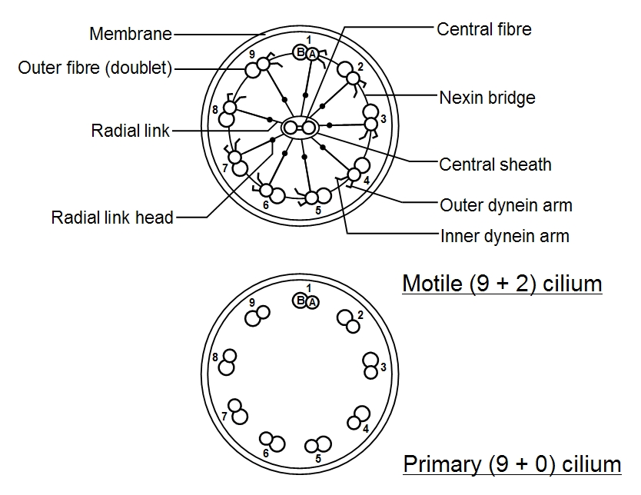
Structure: Compare and Contrast

Slide 6
Where is Primary Cilia found?
Virtually everywhere else!
Eye
Photoreceptors of the retina
Kidney
Line the nephron

Slide 7
What does Primary Cilia do?
Appear nonfunctional
They are non-mobile because they lack dynein arms and radial protein spokes
Some act as a sensory antenna, receiving signals from other cells or fluids nearby
E.g. alert the cells that there is a flow of urine

Slide 8
Cilia Dysfunctions
Smoking
Primary Ciliary Dyskinesia
Hydrocephalus

Slide 9
Effects of Smoking on Cilia
Small amounts of whole smoke or its vapor cause ciliostasis in the respiratory tract
“Smoke from one cigarette causes immediate and irreversible ciliostasis in 5-28 minutes in vitro”
In vivo, this may begin to reverse within 10 minutes (use of only 2 cigarettes)
Prolonged use may have retention of toxic chemicals and compound this time
Chronic slowing of nasal mucociliary clearance
Reduction of beat frequency of cilia
Can cause cilia to beat out of sync, making movement inefficient

Slide 10
Effects of Smoking on Cilia
Damage to the lungs natural repair mechanisms
Destruction of cilia
Remaining cilia may be slowed for up to several hours
Mucous cells in lungs grow in size and number producing thicker mucous
Dirt, bacteria, pollution, and chemicals from cigarette smoke are not able to be removed from the lungs
An unproductive cough can be developed from lack of mucous movement

Slide 11
Effects of Quitting Smoking on Cilia
Cilia will begin to grow within three days of quitting
Cough may accompany quitting for several weeks due to cilia working to remove buildups of mucous from the lungs
Many of the lost cilia will be replaced within nine months
Decrease in the amount of mucous
Increased capacity of self-repair in lungs

Slide 12
Primary Ciliary Dyskinesia
What is it?
A genetic lung disorder
What does it do?
Mucous accumulates in the lungs
This causes blockage(s) and results in infection

Slide 13
Primary Ciliary Dyskinesia: Affects
Respiratory system
Inner ear
Reproductive organs
Anywhere else cilia are important
The cilia are what get affected by this dysfunction
Abnormal Cilia
Stunted
Non-synced movement
Non-moving Cilia

Slide 14
Primary Cilia Dyskinesia: Symptoms
Respiratory Distress as a newborn
Chronic cough
Excess mucous
Middle ear infections
Severe sinus infections
Lack of response to antibiotics

Slide 15
Primary Cilia Dyskinesia: Diagnosis
Can be difficult to diagnose
Atypical asthma
Cystic fibrosis
Clues from history and symptoms
A lung biopsy is the last test to confirm the diagnosis

Slide 16
Primary Cilia Dyskinesia: Occurrence
It is a rare genetic disorder
It worsens over time if not treated
Severity of cases vary greatly
Treatment
Early detection
Monitoring

Slide 17
Primary Cilia Dyskinesia: Treatments
No cure
Therapy sessions to clear airways
Washing and suctioning of sinus cavities and ear canals
Prescribed medications
Antibiotics to fight the bacteria that can live in mucous
Steroids
Bronchodilators
Mucolytics (mucus thinners)
Monitoring to prevent bronchiectasis
Stretching and widening of the airways

Slide 18
Hydrocephalus
“Hydro” = water, “cephalus” = head (in Greek)
A condition in which the brain accumulates an excess of cerebral spinal fluid (CSF)
Mainly developed at birth from genetic or fetal development disorders
Can be caused by many things such as defective cilia function, which can lead to the widening of the ventricles within the brain
This can also develop from an under growth of the skull in children, and in adults from a blockage of CSF flow from acute head injury, tumors, meningitis or hemorrhage that can cause blockage of CSF flow.

Slide 19
Hydrocephalus: Symptoms
In infancy
Enlarged head
Vomiting
Irritability
Sleepiness
Seizures
In older children and adults
Nausea and/or vomiting
Double vision
Imbalance
Irritability
Fatigue
Memory Loss

Slide 20
Hydrocephalus: Allopathic Treatments
A shunt system
A flexible plastic tube surgically inserted into the ventricle or exterior to the spinal cord
Complications: over or under draining, mechanical failure, infection, or obstructions that require lengthening or replacement of the tube
Lithium
A trace element found in rocks
Side Effects: nausea, vomiting, dizziness, muscle weakness and fatigue. As well as skin disorders such as acne, psoriasis and rashes

Slide 21
Hydrocephalus: Alternative Therapies
Craniosacral Therapy
A soft touch technique that releases any restrictions of tissue around the cranium down to the sacral region by palpating the rhythm of the CSF pulse around the brain and spinal cord releasing any of these restrictions
Upper Cervical Adjustment
Consists of adjusting C1/ C2 only
Creating realignment of the foramen magnum with the spinal canal in the upper cervical spine allowing for better nerve function.

Slide 22
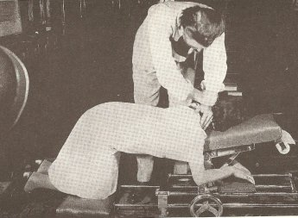
Hydrocephalus: Alternative Therapies

Slide 23
Question 1:
Which of the following is NOT a type of cilia?
A) Motile
B) Mobile
C) Primary
D) Non-Motile

Slide 24
Question 1:
Which of the following is NOT a type of cilia?
A) Motile
B) Mobile
C) Primary
D) Non-Motile
Answer:
B) Mobile

Slide 25
Question 2:
Which of the following is a result of smoking:
A) Increased ciliary beat action
B) Decreased number of mucosal cells
C) Increase in amount of mucous
D) Increase in number of cilia

Slide 26
Question 2:
Which of the following is a result of smoking:
A) Increased ciliary beat action
B) Decreased number of mucosal cells
C) Increase in amount of mucous
D) Increase in number of cilia
Answer:
C) Increase in the amount of mucous

Slide 27
Question 3:
Which of the following is NOT a symptom of Primary Ciliary Dyskinesia?
A) Chronic cough
B) Middle ear infection
C) Sinus infections
D) Anemia

Slide 28
Question 3:
Which of the following is NOT a symptom of Primary Ciliary Dyskinesia?
A) Chronic cough
B) Middle ear infection
C) Sinus infections
D) Anemia
Answer:
D) Anemia

Slide 29
Question 4:
What is not one of the causes of hydrocephalus?
A) Under growth of the skull seen in children
B) Blockage of CSF flow due to head injury
C) Loss of dopamine within the brain
D) Caused by meningitis, tumors, or hemorrhage within the brain

Slide 30
Question 4:
What is not one of the causes of hydrocephalus?
A) Under growth of the skull seen in children
B) Blockage of CSF flow due to head injury
C) Loss of dopamine within the brain
D) Caused by meningitis, tumors, or hemorrhage within the brain
C) Loss of dopamine within the brain (Parkinson’s)

Slide 31
References:
http://faculty.clintoncc.suny.edu/faculty/michael.gregory/files/bio%20102/bio%20102%20lectures/Animal%20cells%20and%20tissues/Animal%20Tissues.htm
https://www.youtube.com/watch?v=8TIkmmwpY5Y
http://www.ciliopathyalliance.org/cilia/structure-and-function-of-cilia.html
http://cronodon.com/BioTech/Cells_motility_3.html
http://www.wisegeek.com/how-does-smoking-affect-the-cilia.htm
Adams, M. (2010). The primary cilium: An orphan organelle finds a home. Nature Education, 3(9):54. Retrieved from http://www.nature.com/scitable/topicpage/the-primary-cilium-an-orphan-organelle-finds-14228249

Slide 32
References Continued:
(2012, Nov.). Adult onset hydrocephalus. American Association of Neurological Surgeons. Retrieved from http://www.aans.org/patient%20information/conditions%20and%20treatments/adult%20onset%20hydrocephalus.aspx
American Lung Association. Retrieved from http://www.lung.org/about-us/our-impact/top-stories/lungs-101-how-does-smoking.html
(2012, Dec. 6) Can’t get there form here: Cilia and hydrocephalus. Nature medicine. Retrieved from http://www.nature.com/nm/journal/v18/n12/full/nm.3011.html
Chiropractic upper cervical care. Upright-health. Retrieved from http://www.upright-health.com/chiropractic-upper-cervical.html

Slide 33
References Continued:
(2001). Discover cranial sacral therapy. Upledger institute international. Retrieved from http://www.upledger.com/content.asp?id=26
Stanley, P. J., Wilson, R., Greenstone, M. A., MacWilliam, L., & Cole, P. J. (1986). Effect of cigarette smoking on nasal mucociliary clearance and ciliary beat frequency. Thorax, 41(7), 519-523.
Mader, S. S. (2010). Human Biology (11th ed.). New York, NY: McGraw-Hill Companies, Inc.
Primary Ciliary Dyskinesia. Retrieved from http://www.lung.org/lung-disease/primary-ciliary-dyskinesia/
Silverthorn, D. U. (2013). Human physiology: An integrated approach (6th ed.). Glenview, IL: Pearson Education, Inc.
UPMC Life Changing Medicine. Retrieved from http://www.upmc.com/patients-visitors/education/breathing/pages/smoking-and-lungs.aspx

